Slide 1
Creating a Noughts and Crosses Game
Mack 2023
Notes:
Last updated: 09-12-20
Resources are updated regularly — the latest version is available at: ncce.io/tcc.
This resource is licensed under the Open Government Licence, version 3. For more information on this licence, see ncce.io/ogl.

Slide 2
Match the key words to the definitions
Starter activity
Iterative testing
Typical, expected data.
Final testing
Incorrect data type e.g. enter string instead of a number.
Erroneous test data
Testing throughout the creation of a program.
Boundary test data
Values just inside the limits.
Normal test data
Testing at the end of program creation.

Slide 3

Lesson 34 and 35: 2D lists challenge
Objectives
In this lesson, you will:
Use a 2D list as part of a programming challenge

Slide 4
Scenario: noughts and crosses
Activity 1
Noughts and crosses is a two-player game that is played on a 3 x 3 grid.
Each player chooses whether to be noughts or crosses.
They then take it in turns to place their piece on the grid.
X | O

Slide 5
Scenario: noughts and crosses
Activity 1
The first player to get three in a row wins.
Pieces can be placed horizontally, vertically, or diagonally to qualify for a win.
X | O | O
 | X | O
 |  | X

Slide 6
Scenario: noughts and crosses
Activity 1
You will create a noughts and crosses game for your next programming challenge.
X | O | O
 | X | O
 |  | X

Slide 7

Play: noughts and crosses
Activity 1
Paired activity .
Play noughts and crosses with a partner.
During game play, think about all of the little steps that need to take place in order for a player to get to a winning position.
X | O | O
 | X | O
 |  | X

Slide 8
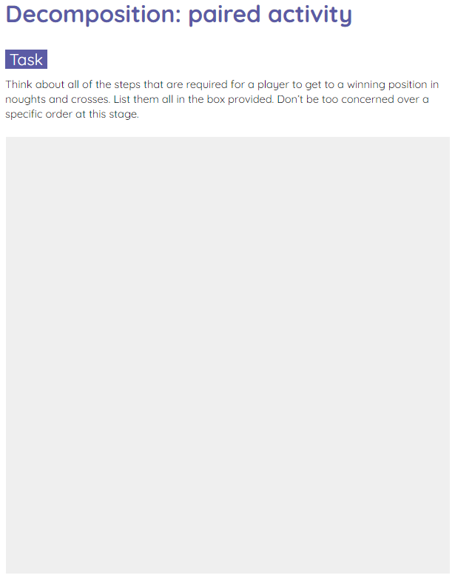

Decompose: noughts and crosses
Activity 2
Paired activity .
Use the worksheet to decompose the noughts and crosses game.
Decomposition means to break down the problem into small, manageable chunks.

Slide 9
Decompose: noughts and crosses
Activity 2
Paired feedback .
What was on your list?

Slide 10
Decompose: noughts and crosses
Activity 2
Display the instructions
Decide who is X and who is O
Draw the board
Player takes a turn
Place piece on the board
Check if a player has won
Move on to the next player
Continue to play until a player wins
Ask to play again
X | O | O
 | X | O
 |  | X

Slide 11
Getting started: noughts and crosses
Activity 3
You now have a basic starting point with your decomposed steps.
The next step is to start forming a structure for the game.
A structure chart has been created to support you with the planning of this game.

Slide 12
Getting started: noughts and crosses
Activity 3
Noughts and crosses
Game instructions
Display board
Play the game
Read for valid position
Move a player piece
Check for a win
identifier
instructions
parameters
board
return
none
identifier
displayboard
parameters
board
return
none
identifier
play
parameters
board
return
none
identifier
readpositions
parameters
player
return
position
identifier
move
parameters
board, player
return
board
identifier
check_win
parameters
board, player
return
won

Slide 13
Getting started: noughts and crosses
Activity 3
Noughts and crosses
You will start by implementing these sections.
Game instructions
Display board
Play the game
Read for valid position
Move a player piece
Check for a win
identifier
instructions
parameters
board
return
none
identifier
displayboard
parameters
board
return
none
identifier
play
parameters
board
return
none
identifier
readpositions
parameters
player
return
position
identifier
move
parameters
board, player
return
board
identifier
check_win
parameters
board, player
return
won

Slide 14
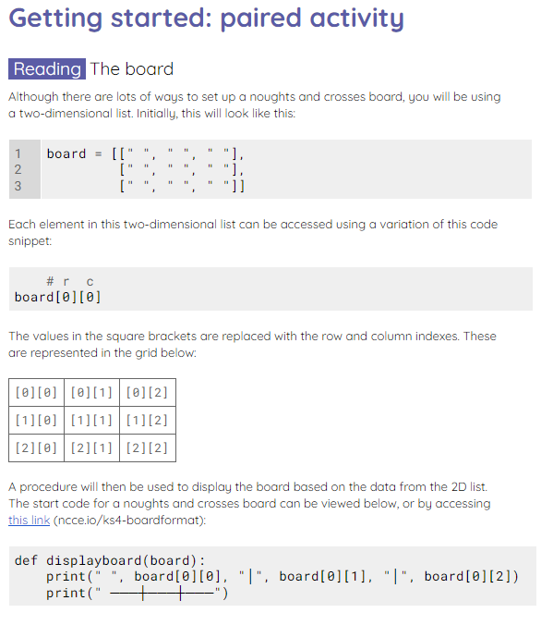
Getting started: noughts and crosses
Activity 3
Paired activity .
Use the worksheet to help you think about:
Displaying the board
Checking for a win

Slide 15
Create: noughts and crosses
Activity 4
At this stage, you have now made a start with two sections of the game.
You can see these are now complete on the structure chart.

Slide 16

Create: noughts and crosses
Activity 4
Noughts and crosses
Game instructions
Display board
Play the game
Read for valid position
Move a player piece
Check for a win
identifier
instructions
parameters
board
return
none
identifier
displayboard
parameters
board
return
none
identifier
play
parameters
board
return
none
identifier
readpositions
parameters
player
return
position
identifier
move
parameters
board, player
return
board
identifier
check_win
parameters
board, player
return
won
Notes:
Image source: https://pixabay.com/vectors/approved-button-check-green-round-151676/

Slide 17
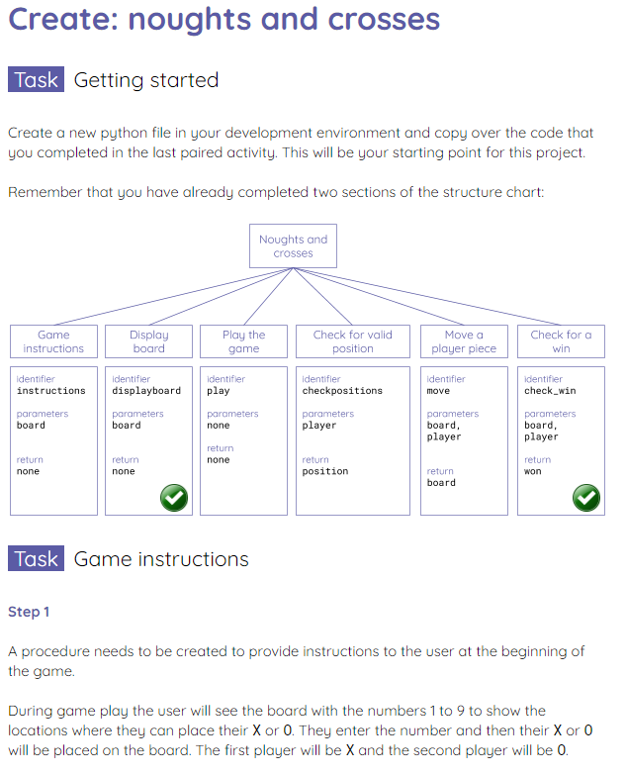
Create: noughts and crosses
Activity 4
Independent activity .
Use the worksheet to help you complete the rest of the game.
There will be further decomposition required for each part of the program.

Slide 18


Learning partner time
Activity 5
Use the next five minutes to discuss any programming issues that you might be having with your learning partner.
Complete the feedback journal to keep a log of your comments.

Slide 19
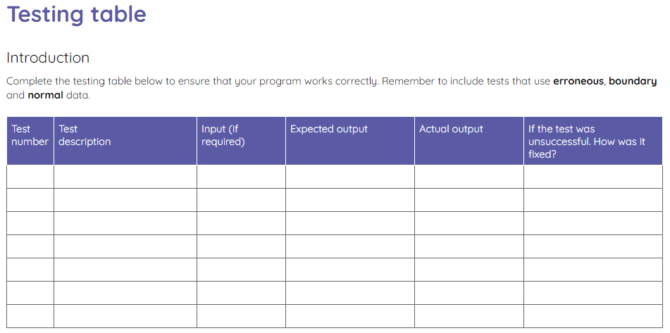
Test the program
Activity 6
Use the testing table to complete a final test of your program. Make sure that you include:
Erroneous data
Boundary data
Normal data

Slide 20
Learning partner time
Wrap Up
Use the last five minutes to discuss any programming issues that you might be having with your learning partner.
If you have reached the end of your project, discuss your strengths in the project and think about how you could improve next time.
Complete the feedback journal.

Slide 21
Next lesson
Summary
In these lessons, you…
Created a noughts and crosses game
Next lesson, you will…
Learn about the dictionary data structure

